Slide 2
Detailed description of labelling the data

Slide 3
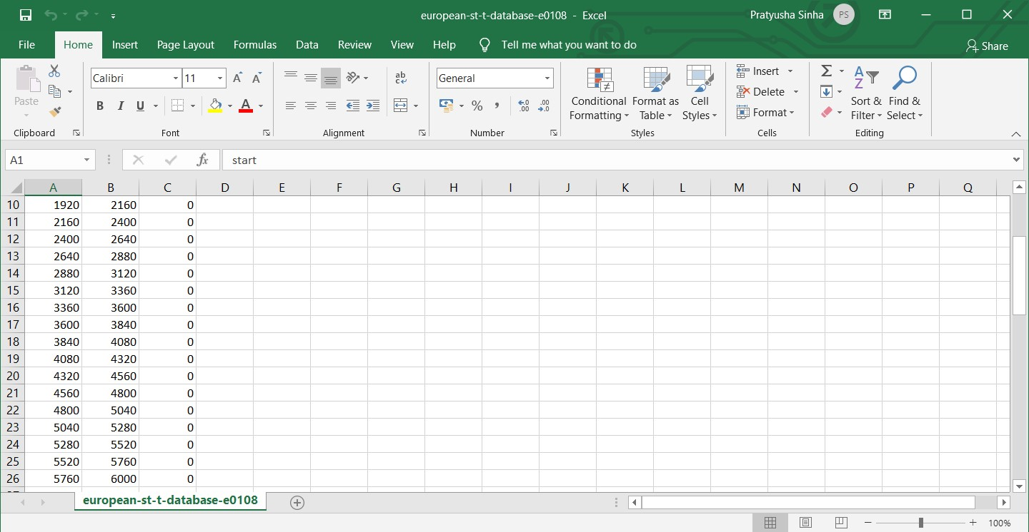
Labelling of data for CNN
We took four European-st-t-database, e0103,10104,e0105 and e0108 respectively.
In each data set we run a code where the dataset is divided into segments having 240 data point each(a typical heart rate has 70 to 75 beats per minute, i.e. each cardiac cycle takes about 0.8 seconds to complete the cycle).
During each interval, a pqrst wave is generated of that particular interval and thereafter we label our data according to the shape of the graph.
We label the data as 1 when the shape of the graph does not match with the general shape of pqrst wave and 0 otherwise.
And the data recorded in csv file.
After performing the same on each of four the dataset , we got 2891 normal and 1294 abnormal pqrst segments.

Slide 4
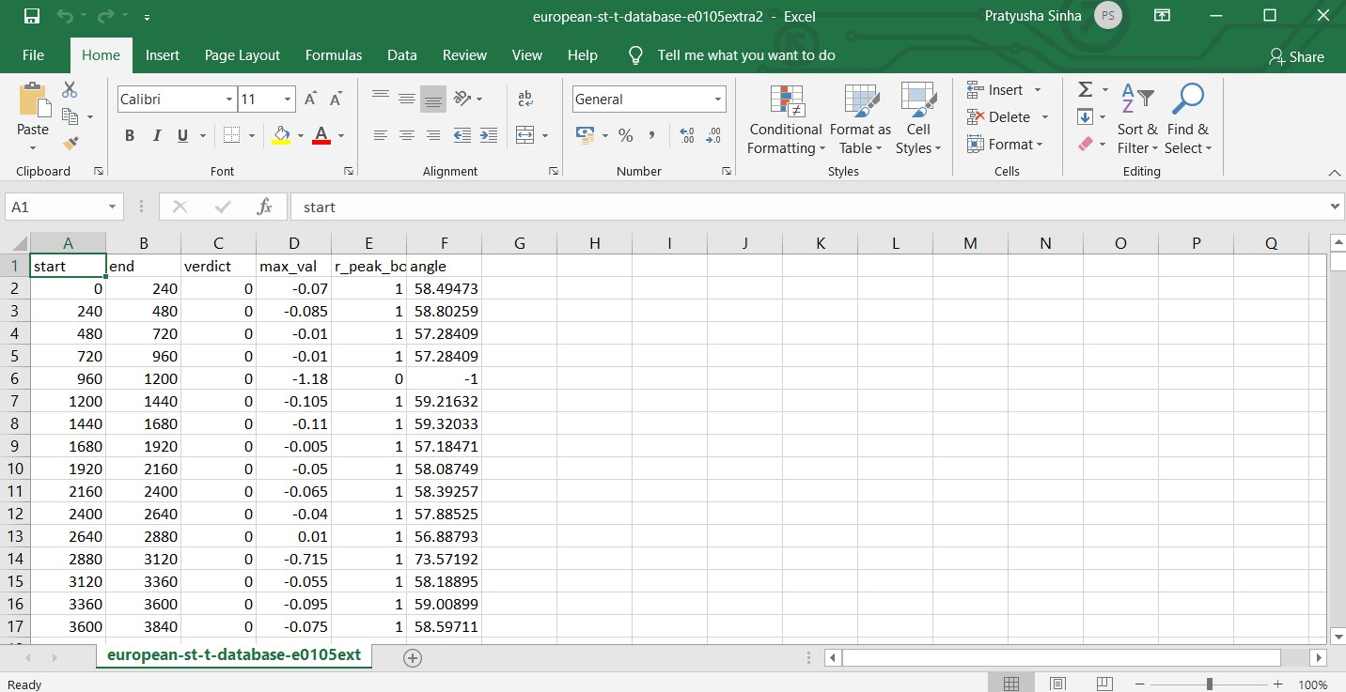
Measuring the angle value of r peak of abnormal segments.
After labelling the datasets, we decide to calculate the angle and amplitude of the peak of segments having r peak and store the value in csv file.
In the given figure, we calculated the angle value of normal pqrst waves.
In row 6, we can see that the r peak value is 0, when the peak is too low as compared to others. In such condition, we place value of angle as -1.
The normal value range of r peak is found to be between 56-59.
If the value of angle is greater than 59 and less than 56, then the particular qrst wave is considered abnormal.

Slide 5
1D CNN model

Slide 6
architecture of the model

Slide 7
metrics of the model
sensitivity
specivity
F1 score
MCC

Slide 8
Future Scope
Better accuracy
Better explainability using angles
Better training data by validating the training data with the help of professionals

